Slide 1
Accentuate the Positive: Autism in Kink
Drummer Pony

Slide 2
Agenda
What are the positive aspects of your autism?
Kink and Autism – Do they go together?
Navigating Social and Sensory Intensity

Slide 3
What are the positive aspects of your autism?

Slide 4
Models of Disability
Medical Model
Social Model
The person is disabled by the abnormalities and deficits of their own body and/or brain.
Disabled people are broken, abnormal, or damaged versions of human being and should be fixed, cured, and/or prevented.
Since the disabled person’s impairments prevent them from functioning normally, they need caregivers and professionals to make decisions for them. The disabled person is an object of charity and receiver of help.
The disabled person should adjust to fit into society, since they are the one who is not normal. Being part of society means rising above disability.
The person is disabled by their environment and its physical, attitudinal, communication, and social barriers.
Disabled people are normal, valid varieties of human being and should have equal rights and access to society, just as they are.
Since the disabled person is inherently equal, they have a right to autonomy, choice, and free and informed consent in their own lives.
The disabled person should be supported by society, because they are equal and have a right to inclusion. Their community should adjust its own barriers and biases.
https://eisforerin.com/2017/08/05/disability-101-medical-model-vs-social-model/

Slide 5
Positive, or Exploitable?
We are taught that some positive aspects of neurodivergence are the traits that can be profitable
Positive traits can be anything you consider to be positive
We often threaten the status quo

Slide 6
Kink and Autism – Do they go together?

Slide 7
Disclaimer!

Slide 8
Dermatillomania isn’t strange to a piquerist
Stimming: Repetitive movements or noises
Nuanced understanding of stimming, positive relationships to sensation and pain
Variety of stimming methods
Incorporating stimming in kink

Slide 9
Rules, Rules, Rules
Clear and explicit rules in dungeons and events
Culture that emphasizes consent
Rituals and structure
Protocol, 24/7 D/s, Power Exchange

Slide 10
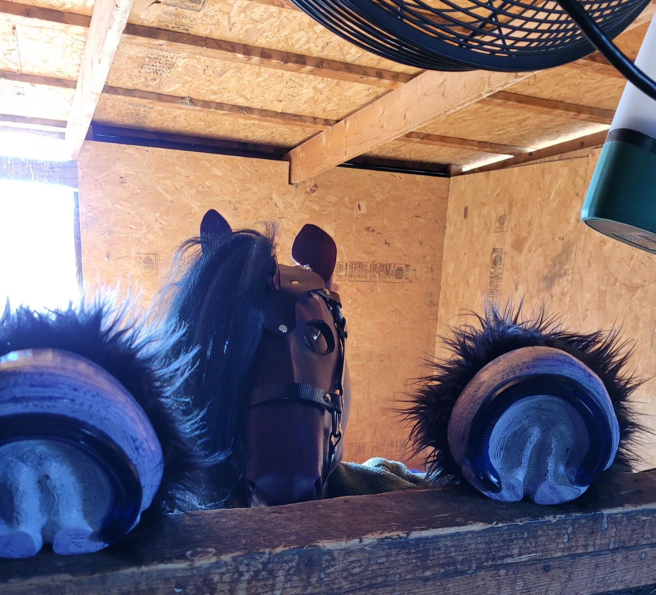
Indulgence in Silliness and Creativity
Freedom to explore roleplay, costumes, artistic expression without judgement

Slide 11
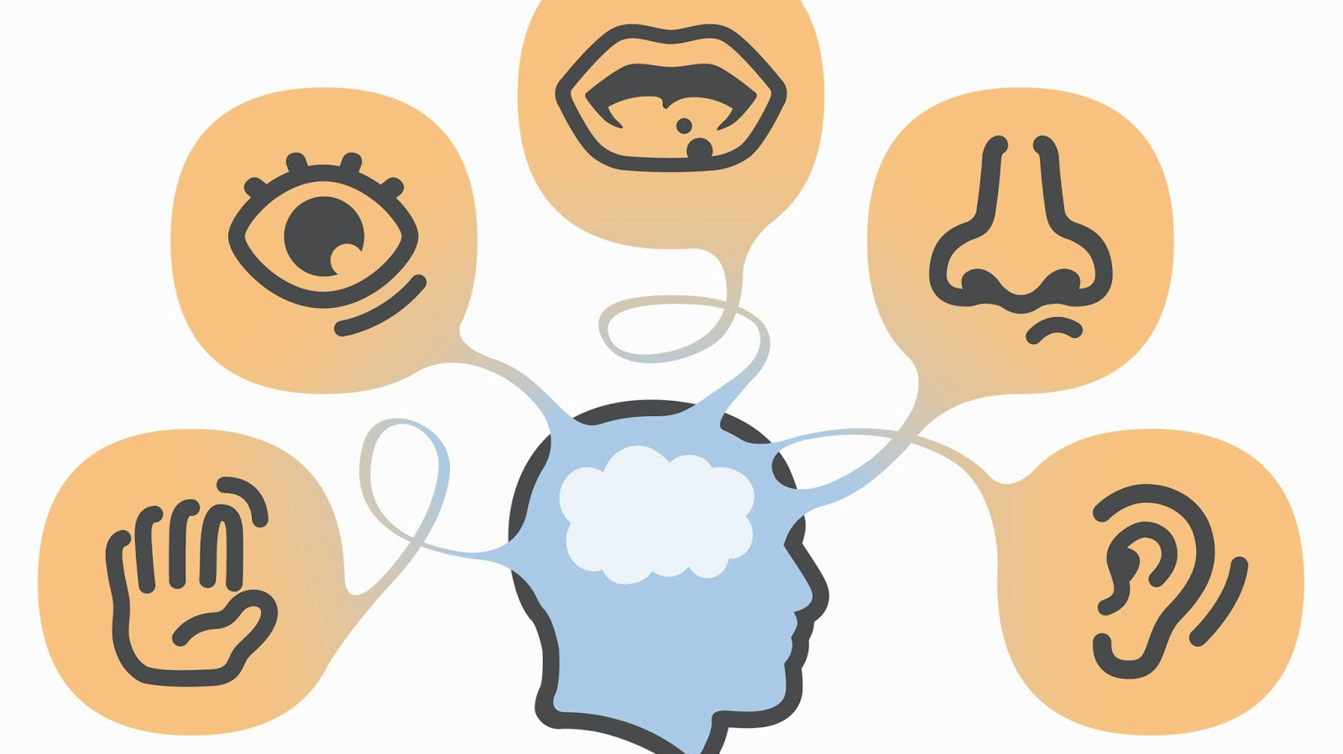
Relationship to Sensation
Sensory Play
Sadomasochism
Hypnosis and Subspace

Slide 12
Navigating Social and Sensory Intensity

Slide 13
Talking to Partners
Learning about yourself
Being up-front
Self-advocacy
Love languages
Infodumping
Parallel Play
Support Swapping
Practice?
https://boren.blog/2021/07/11/the-five-neurodivergent-love-languages/

Slide 14
Munches and Dungeons
Contact the munch organizer beforehand
It is okay to leave early
Most dungeon venues and informal dungeons have non-kink spaces
Researching venues
Have friends to support you

Slide 15
How can dungeons be more accommodating?
And how can they EMBRACE us?

